Slide 1
Becky Stevenson
Business Improvement Consultant

Slide 2
Customer Journey:
have you got the basics in place?

Slide 3
Customer Experience…
…is your number 1 priority

Slide 4
Why….
65% of buyers find a positive experience with a brand to be more influential than great advertising

Slide 5
Why….
73% of buyers state customer experience as an important factor in purchasing decisions

Slide 6
Why….
67% of customers leave because of a bad experience… but only 1 in 26 complain

Slide 7
Why….
86% of buyers are willing to pay more for a great customer experience

Slide 8
Buying journey
The Customer journey needs to be adapted according to the emotional and financial investment
…but remember ever one is different and it depends on your client type
High
House
Emotion
Car
Book
Financial investment
High
Low

Slide 9
Example Customer Journey…
Let’s take a walk through of a real life example and see the touch points…

Slide 11
Finding an estate agent to sell our flat…
Boards in my area
Website
My social media
Their social media
Official Reviews
Face to Face Meeting & Valuation
Quality of follow up
In the buyers shoes
Price

Slide 12
Who we choose
Important to us
Estate Agent 3
Local Business
Amazing feedback
Human, down to earth but super professional and slick
Passed my “tests”
Technology – online hub
Good value / Cost (standard price)

Slide 13
TIME TO WALK IN YOUR CUSTOMERS SHOES…

Slide 14
Customer Journey: The key areas
Awareness
Consideration
Purchase
Retention
Advocacy

Slide 15
What is your Customer Journey?
Awareness
Consideration
Purchase
Retention
Advocacy

Slide 16
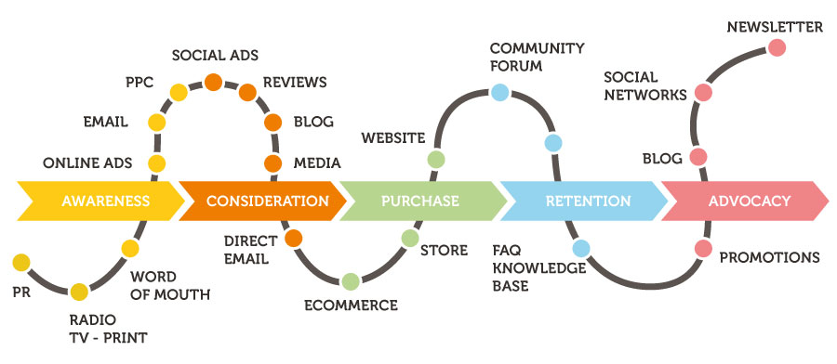

Slide 17
Your touch points
Think about EVERY interaction your customer has with you
What is it (email, call, booking)
How do you handle it?
Outsourced/Inhouse
Could it be better? Different?
Do you wow?

Slide 18
Homework
Take some time to figure out all the processes you have in your business and write them down
Take time to review, refine and develop regularly
Seek help and guidance if you need it

Slide 19
Remember the basics…
First impressions count but final ones are the longest lasting
Listen to the subtle clues and action these
Listen, react, deliver and go above and beyond

Slide 20
“Just having satisfied customers isn’t good enough anymore. If you really want a booming business, you have to create raving fans.”
Ken Blanchard

Slide 21
Connect with me
www.beckystevenson.co.uk
Facebook | LinkedIn | GMB
Download MORE TIPS !
Over 15 tips straight to your inbox
www.subscribepage.com/i5y0w5
Copyright © 2021 Becky Stevenson. All rights reserved. Any redistribution or reproduction of part or all of the contents in any form is prohibited. You may not, except with my express written permission, distribute or commercially exploit this content, nor may you transmit it or store it in any other website or other form of electronic retrieval system

